Slide 1
SIMPLE MAP OF OUR PROJECT
manipulate participant
manipulate protagonist
object (e.g. graspable handle)
visual perspective (Pavlidou et al)
congruency of motor (body) representation / visuo-proprioceptive signals
goal
registration (mind)

Slide 2
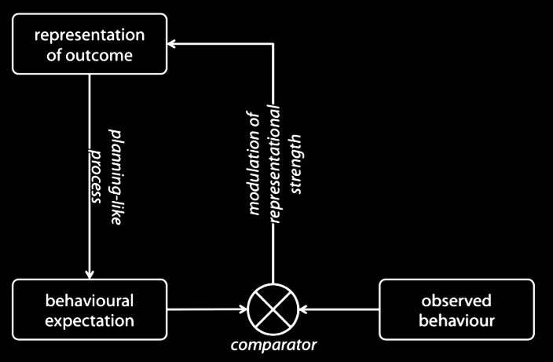
BASIC FIGURE (motor -> goal)

Slide 3
NEW FIGURE (motor -> *)
(involves perspective + object)
expectation concerning perspective !?
observed perspective
expectation concerning object
observed object

